Slide 1
Foundations of Data Science
Exploring and Understanding the Insurance Dataset
- Yugratna Humagain

Slide 2
Introduction
Objective:
Cleanse, analyze, and visualize real-world data before modeling.
Reveal the story hidden in the insurance dataset.
Tools Used:
Python, pandas, numpy, matplotlib, seaborn

Slide 3
Data Discovery & Initial Inspection
Dataset: insurance_cleaned.csv
Rows & Columns: 1337 rows, 9 columns
Features: age, sex, bmi, children, smoker, region, charges
Extracted Feature: age_group, bmi_category

Slide 4
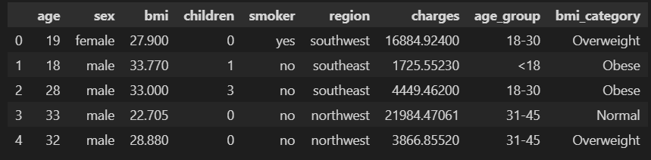
Sample Data

Slide 5
Data Wrangling
Missing Values: No missing values in any column (df.isnull().sum())
Data Types: Correctly assigned (int, float, object)
Feature Engineering:
Created age_group (e.g., Young, Middle, Senior)
Created bmi_category (e.g., Underweight, Normal, Overweight, Obese)

Slide 6
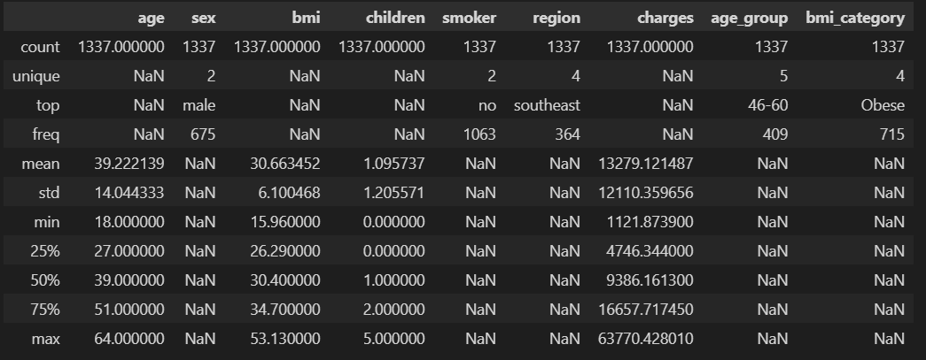
Data Wrangling (Summary Statistics)

Slide 7
Univariate Analysis
Numeric Features:
Age: Nearly symmetric distribution (skewness ≈ 0.05)
BMI: Slightly right-skewed (skewness ≈ 0.28)
Charges: Strong right skew (skewness ≈ 1.52)
Categorical Features:
Balanced distribution for sex, region, etc.
(Histograms and countplots in EDA notebook)

Slide 8
Bivariate Analysis (Overview)
Scatterplots:
Age vs. Charges: Positive trend
BMI vs. Charges: Higher BMI, higher charges (especially for smokers)
Pairplot: Visualizes relationships and distributions across key variables
Correlation Heatmap:
Charges highly correlated with age, bmi, and smoker status

Slide 9
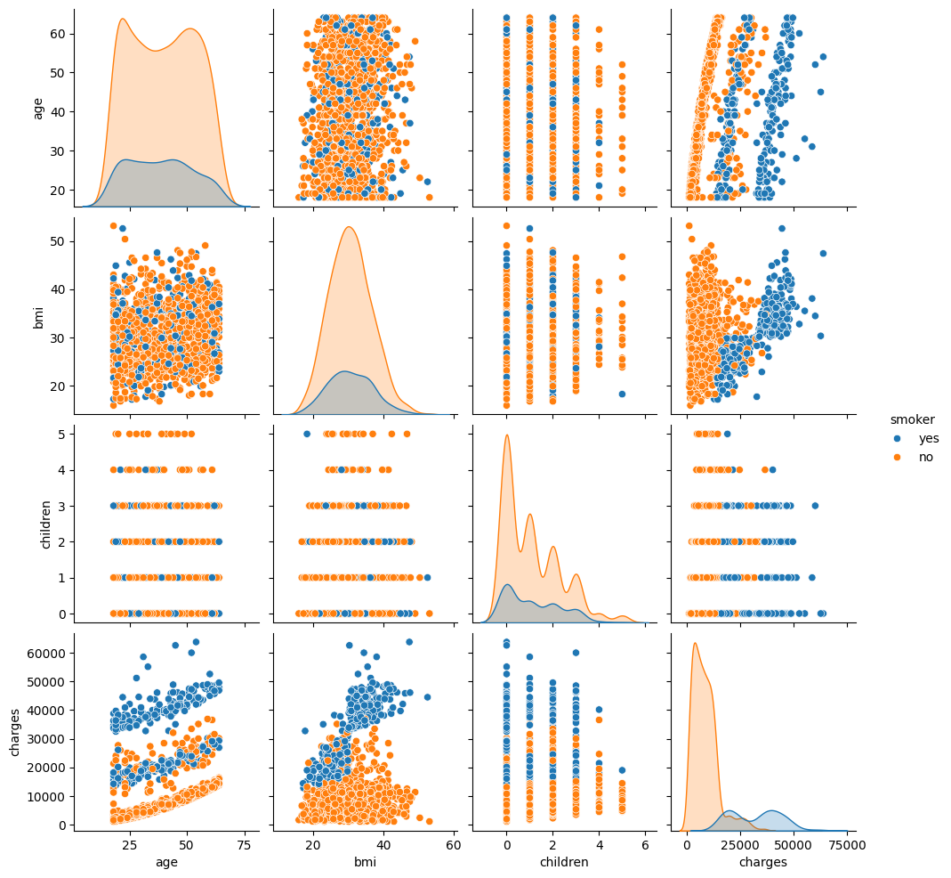
Bivariate Analysis (Pairplot)

Slide 10
Bivariate Analysis (Pairplot)
Smokers (blue) face higher insurance charges than non-smokers (orange).
Age-related charges increase steeper for smokers.
Higher BMI correlates with higher charges, especially for smokers.
Children's number doesn't strongly impact charges.
Smokers dominate the high-charge range, a minority.

Slide 11
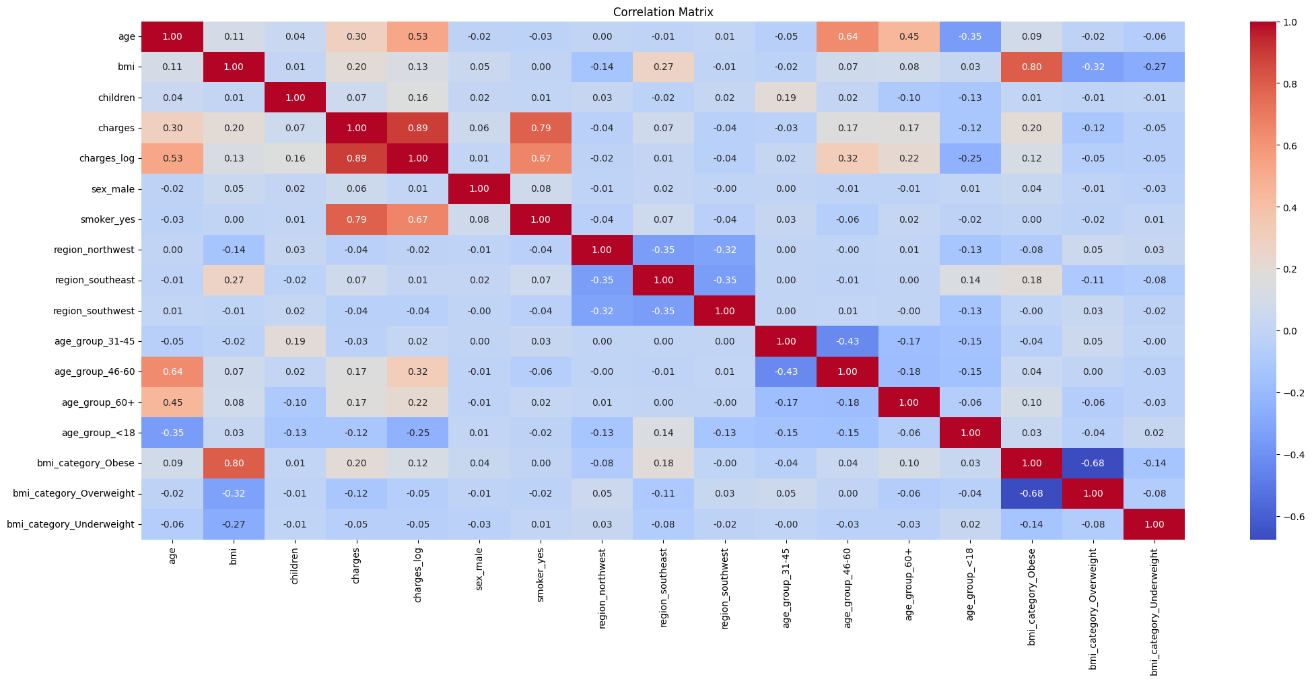
Bivariate Analysis (HeatMap)

Slide 12
Bivariate Analysis (HeatMap)
Strongest Correlations in Charges
High correlation with smoker_yes (0.79).
Strong positive correlation with age (0.30).
Moderate correlation with bmi (0.20).
Log-transformed charges show stronger correlation with age (0.53).
Weak/No Correlation
Children, sex, and region have weak or near-zero correlation with charges.
Most regions do not significantly affect charges.

Slide 13
Outlier Detection & Treatment
Boxplots:
Outliers present in bmi and charges
Treatment Methods:
IQR filtering (reduced dataset size)
Capping extreme values
Median imputation
Z-score filtering
(Before/after boxplots in EDA notebook)

Slide 14
Key Insights
Smoker Status:
Smokers pay significantly higher charges.
Age & Charges:
Older individuals tend to have higher charges.
BMI & Charges:
Obese individuals, especially smokers, incur the highest charges.
Region & Charges:
Minor regional differences.

Slide 15
Data Visualization with Matplotlib
Basic Plots:
Line, scatter, bar, histogram (demonstrated with sample and real data)
Customization:
Titles, labels, legends, figure size, saving plots

Slide 16
Storytelling & Conclusions
The Story:
Health insurance charges are driven by age, BMI, and smoking.
Data wrangling and EDA reveal hidden patterns and outliers.
Visualizations make complex relationships clear and actionable.
Next Steps:
Use these insights for predictive modeling or targeted interventions

Slide 17
THANK YOU!!!

